Slide 1
Planning Your Career and Education
Chapter 5

Slide 2

Keep Your Eyes on the Future
Stay informed about new developments that will affect your future.

Slide 3

Baby Boomers, Generation X, Millennials, Generation Z, and the new Generation Alpha

Slide 4

What is Your Generation?
Baby Boomers 1946-1964
Generation X 1965-1977
New Millennials 1977-1995
Generation Z 1995-2010
Generation Alpha 2010-Present

Slide 5

Baby Boomers
Born between 1946 and 1964
Four out of every ten adults today
The population is getting older
How will the Baby Boom generation affect careers of the future?

Slide 6

Generation X
Born between 1965 and 1977

Slide 7
Advantages of Generation X
More highly educated
Greater demand for skilled workers
Computer literate
Good work ethic
As Baby Boomers retire, more job opportunities

Slide 8

The New Millennials
Born between 1977 and 1995

Slide 9
The New Millennials
Sometimes called the “Echo Boomers”
The largest generation in U.S. history
Will exceed the number of Baby Boomers
In the next 10 years, college enrollments will increase by 300,000 students per year
College admission will become increasingly competitive.

Slide 10

The New Millennials
The cyber generation
Their most important values are individuality and uniqueness
Greatest concerns: terrorism and school shootings
Decreasing use of alcohol, drugs and tobacco
Have the promise of changing institutions for the better

Slide 11

Generation Z
Born since 1995
Many Names: Generation Wii, iGeneration,Gen Tech, Digital Natives, Net Gen, The Plurals

Slide 12
Generation Z
Also known at Generation Wii, iGeneration, Gen Tech and Digital Natives
Will use technology as a tool to change the world
Value cultural diversity
The age of “girl power”

Slide 13
Generation Z
Last generation with a Caucasian majority
Accept diversity
Decline of “traditional families”
Because of recession, less likely to believe in the American dream of having more
The age of “girl power”
Hope to use technology to change the world

Slide 14

Generation Alpha 2010-Present
Born entirely in the 21st Century
Facing great uncertainty, rapid changes in society, and changing economic opportunity

Slide 15
Generation Alpha Emerging Trends
Continued health and economic problems resulting from the pandemic of 2020-21.
Increasing threats from climate change.
Lack of access to healthcare.
The effects of racial injustice.
Decrease in civility and increased divisions in society.
Need for mental health services because of increased anxiety and stress.

Slide 16

Career Trends 2024-2030

Slide 17
Artificial Intelligence (AI)
Benefits
Increased productivity
Improved healthcare
Increased access to education
New careers
Challenges
Some careers will be eliminated
Greater automation in all careers

Slide 18
Artificial Intelligence and Careers
AI will create more jobs than it replaces.
Important to acquire skills in AI to keep up with new and changing careers.
People skills such as collaboration, teamwork, communication, time management and adaptability will become more important as careers adapt to AI.

Slide 19

New High Paying Careers
AI will create many new careers that pay over $100,000 a year.

Slide 20

Flexibility and Working from home
Teleworking
Using smart phones to do some work at home
Virtual Collaboration
Using Zoom, Skype and other tools
New Media
Required for job success

Slide 21

Diversity
Productivity and profits are increased when a diverse group of people feel appreciated and work together.

Slide 22
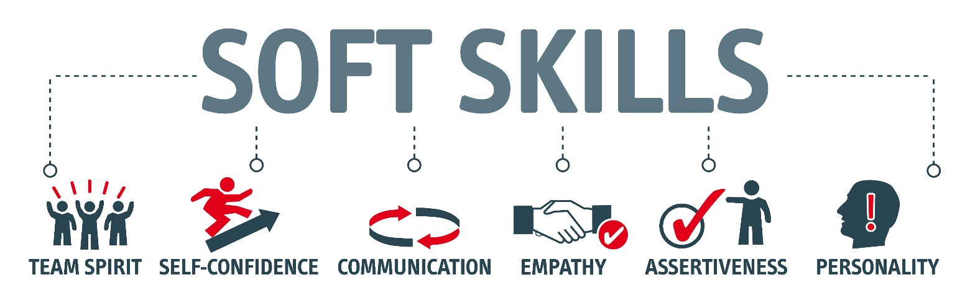
Preference for Soft Skills

Slide 23

Careers of the Future: Business
Finance
Investments
Taxes
Entrepreneurship and small businesses
E-commerce

Slide 24

Going Green!
Efficient use of energy
Renewable sources of energy
Preserving the environment

Slide 25

Environmental Science
Conserve water
Control pollution
Manage global warming
Produce food

Slide 26
Energy Shortages
Recycling
Alternative energy
Concerns about global warming and climate change

Slide 27
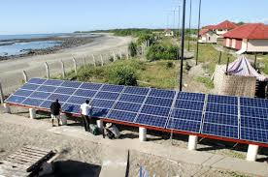


Going Green!
As fossil fuels are depleted, look for more:
  Wind turbines
  Solar panels
  Biofuels
  Emphasis on sustainability
  Taking care of the environment

Slide 28

Green Jobs
Environmental lawyer
Green architect
Sustainability consultant
Marine biologist
Environmental technician
Energy efficiency specialist
Organic farmer
Compliance manager
Product engineer
Wind energy engineer
Solar Engineer

Slide 29

Higher Earnings in STEM Occupations

Slide 30

Research
Engineering
Chemistry
Engineering
Biology
Biotechnology
Requires advanced degrees

Slide 31

Technology
Information and technology workers are the largest group of workers in the U.S.

Slide 32

Mismatch between workers and jobs
More workers needed in scientific and technical fields

Slide 33
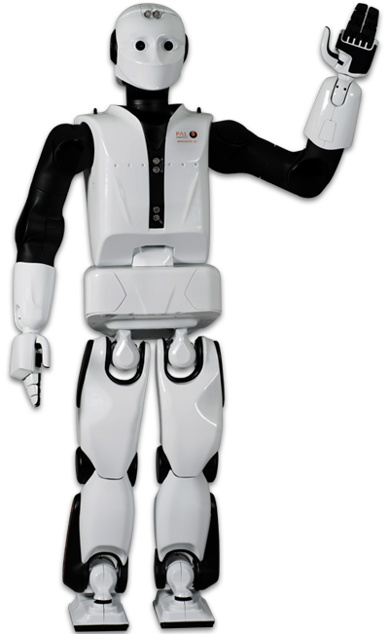
Automation
Robots will do the work
Engineers and technicians will be needed to design and maintain the robots

Slide 34
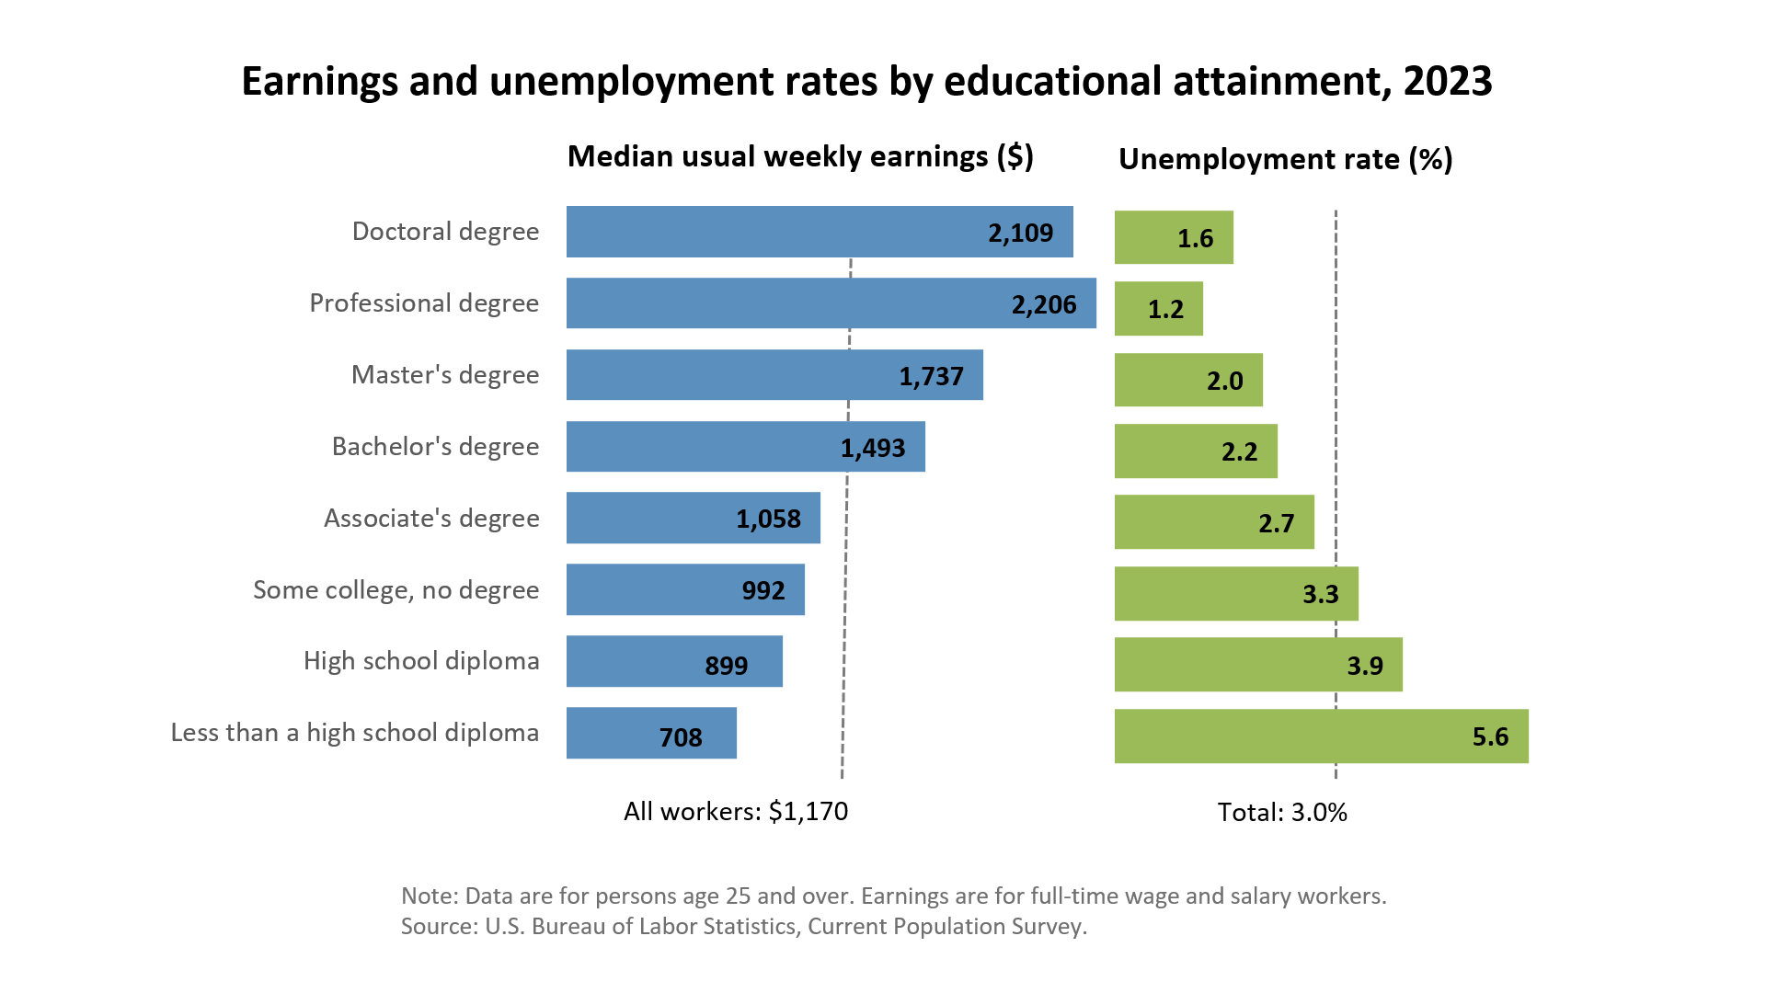
Increased Need for Education

Slide 35
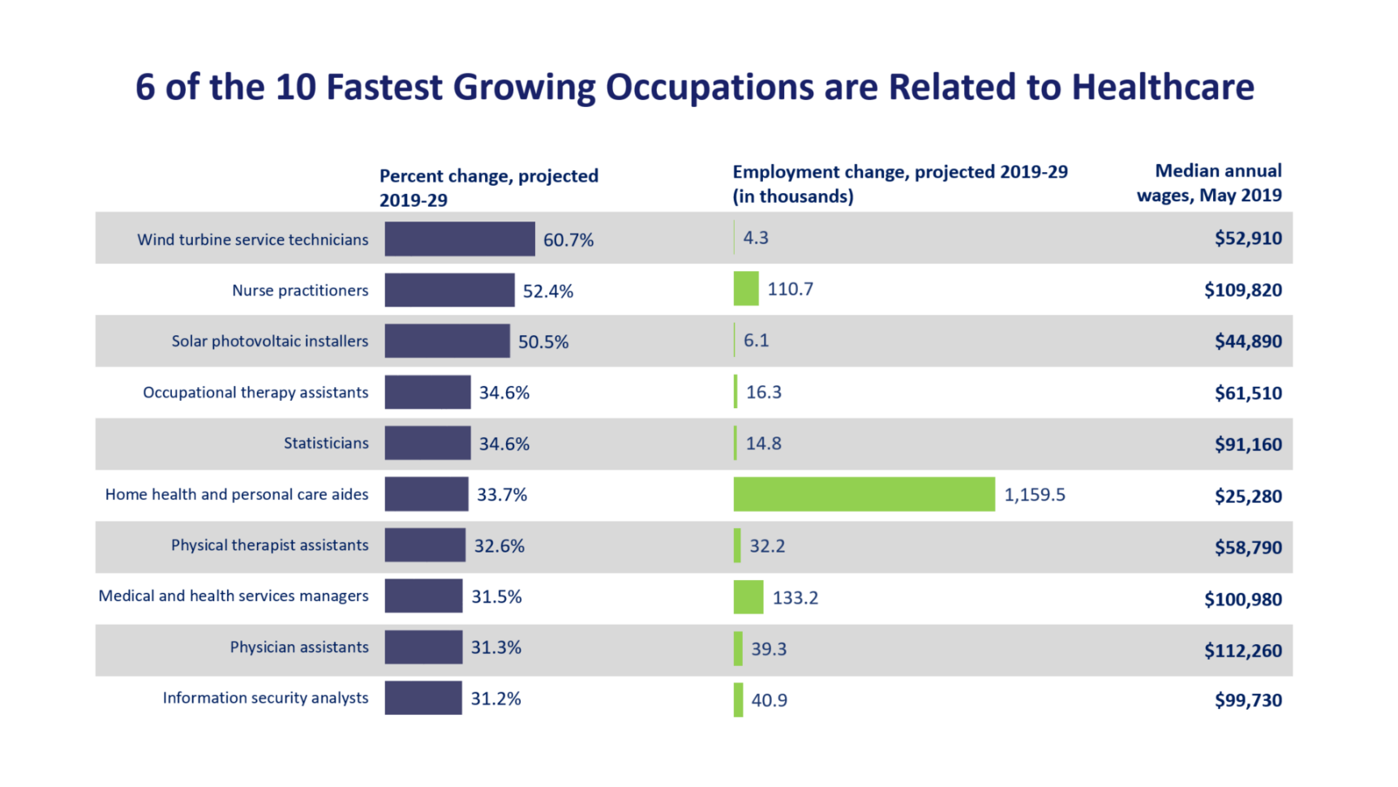
Increasing Opportunities

Slide 36


Largest Numerical Openings
Registered nurses
Home health aides
Customer services rep
Food preparation workers
Personal and home care aides
Retail salespersons
Office clerks
Accountants and auditors
Nursing aides, orderlies
Postsecondary teachers

Slide 37

Increased Opportunities in Healthcare
Most of the new jobs will be in healthcare.

Slide 38
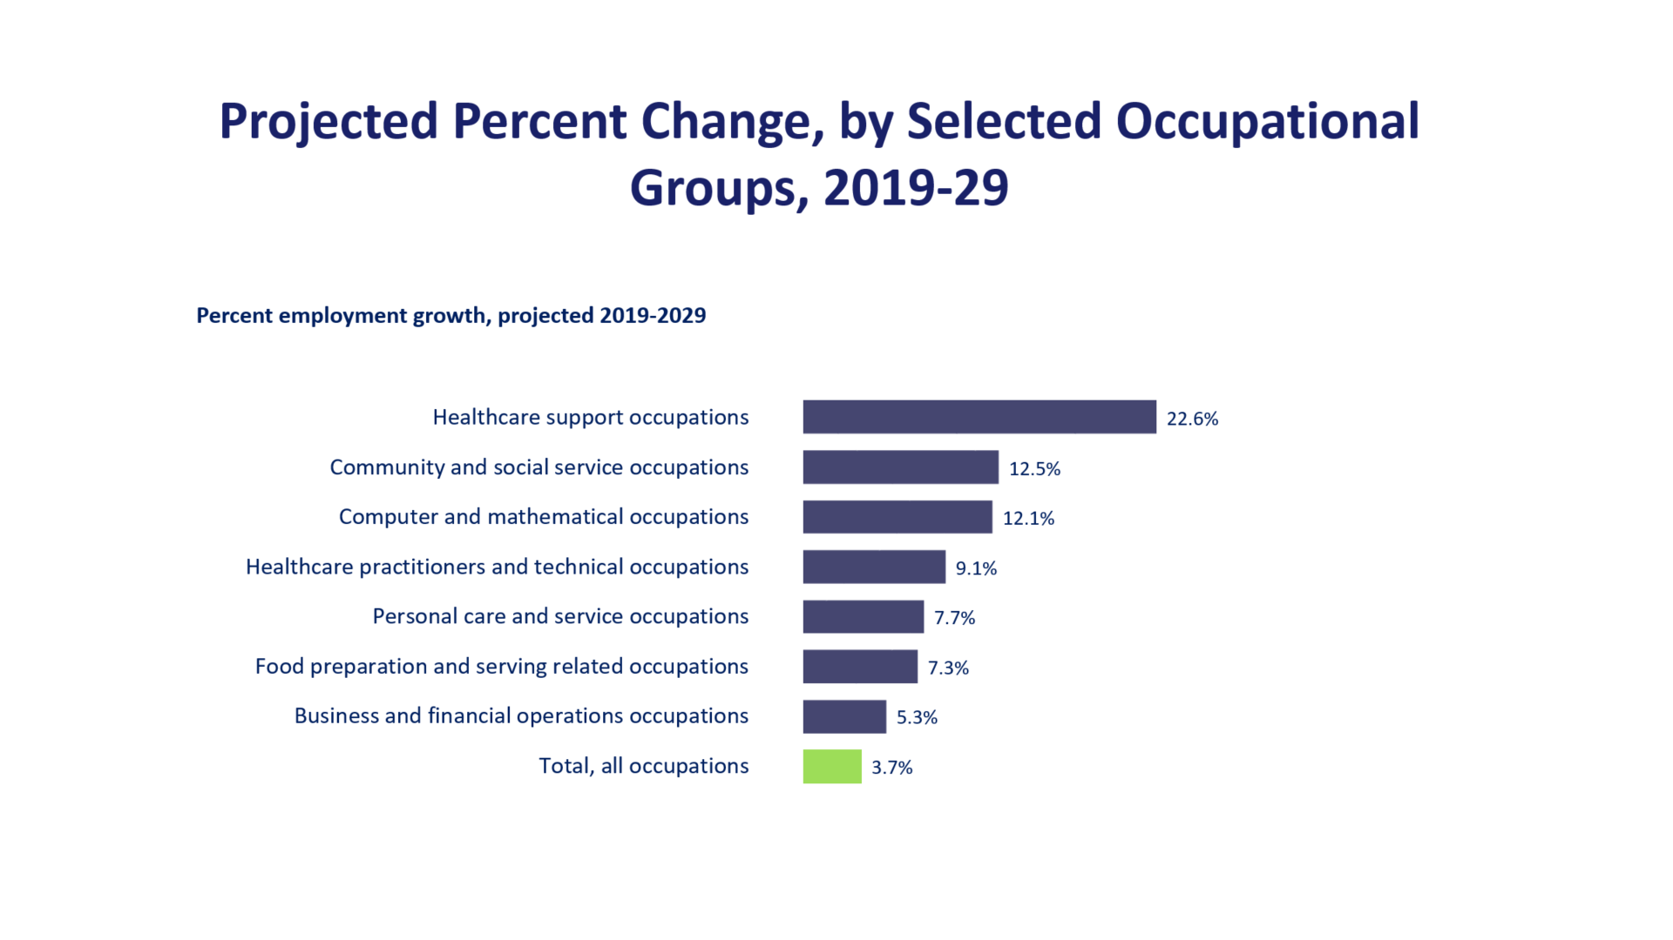
Employment Growth

Slide 39

Service Occupations in Demand
Health Care
Business
Education
Finance
Insurance
Real Estate
Transportation
Communication

Slide 40

Mental Health
Because of increasing violence, we are starting to realize the importance of mental health

Slide 41

Teaching
As older teachers retire, there will be an increasing need for teachers.

Slide 42

Security
Law enforcement
Intelligence
Forensics
International relations
Foreign affairs
Security administration

Slide 43

Top Jobs for the Future
Business
Education
Entertainment
Health
Information Technology
Travel/Transportation
Law/Law enforcement
Services
Sports and related
Technology
Trades

Slide 44
10 Highest Salary Increase
Management Scientific, Technical
Physicians
Computer Systems design
General merchandise stores
Employment Services
Local government
Home health care services
Services for elderly and disabled
Nursing care facilities
Full-service restaurants

Slide 45
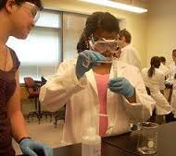

Top Paying Jobs
Require math and science
Chemical engineering
Computer engineering
Occupational therapy
Electrical engineering
Aerospace engineering
Computer science
Civil engineering
Nursing
Environmental engineering
Construction management
Physics
Economics

Slide 46

The TruTalent Skills Assessment
Rate Your Skills for Success
In the workplace

Slide 47


Basic Skills Required
Reading
Math
Writing
Listening
Speaking
Computers

Slide 48

Thinking Skills
Creative Thinking
Decision Making
Problem Solving
Mental Visualization
Knowing How to Learn
Reasoning

Slide 49

Personal Qualities
Responsibility
Self-esteem
Sociability
Self-management
Integrity and Honesty

Slide 50

How to Research Your Career

Slide 51

Career Description
Nature of the work
Working conditions
Training
Qualification
Advancement

Slide 52

The Career Outlook
Salary
Availability of employment
Will this career exist in the future?

Slide 53

To Research Your Career
Use the search tools in your assessment results.
Visit the Career Center.
Use the library.
Use AI to research career information.

Slide 54

Planning Your Education
Vocational Certificate?
Associate Degree?
Bachelors Degree?
Masters Degree?
Doctorate Degree?
Professional Degree?

Slide 55

Degrees
Associate of Arts Degree 2 years
Bachelor’s Degree 4 to 5 years
Teaching Credential BA + 1 year
Master’s Degree BA + 2 years
Law Degree BA + 3 years
Professional Degree BA + 4 to 5 years

Slide 56

How Many Units Do I Need to Graduate?
1-29 units Freshman
30-59 units Sophomore
60-89 units Junior
90+ units Senior
Total number of units for graduation depends on the university and major

Slide 57

Develop and Educational Plan
It is the roadmap to your future.

Slide 58
Steps in Planning Your Education
Assess your skills
1
Take English the first semester
2
Start math classes early
3
Take general education
4
Prepare for your major
5

Slide 59

For Your Success
See a counselor or adviser
Develop an educational plan

Slide 60
Making a Career Decision

Slide 61

There is a choice you have to make,
In everything you do.
And you must always keep in mind,
The choice you make, makes you.

Slide 62

Steps in Making a Career Decision
Self-assessment
  Personality, Interests, Values, Skills
Explore Options
Research careers
Plan your education
Make a commitment and take action
Evaluate
How is it working?

Slide 63
Planful Decisions
Weigh the consequences
What are the pros and cons

Slide 64
Use Planful Decisions for:
What is my major?
What is my career?
Who should I marry?

Slide 65
Steps in Planful Decisions
State the problem
Consider your values
What are your talents?
Gather information
Generate alternatives
Evaluate the pros and cons of the options
Select the best alternative
Take action

Slide 66

Group Activity: Planful Decision

Slide 67
Keys to Success:
Life is a Dangerous Opportunity

Slide 68
The Chinese Word for Crisis Has Two Characters:
Danger
Opportunity

Slide 69
What is the danger?
What is the opportunity?

Slide 70

Every adversity has the seed of a greater benefit or possibility.

